Slide 1
Data Science Laboratory Department of Mechanical and Industrial Engineering Ryerson University
On the Use of Hidden Markov Model
to Predict the Time to Fix Bugs
Mayy Habayeb, Syed Shariyar Murtaza, Andriy Miranskyy, Ayse Basar Bener
Feb 9th, 2018
Notes:
1

Slide 2
Outline
Introduction
Approach
Dataset
Experiments
Threats to Replication
Notes:
Mention Objective

Slide 3
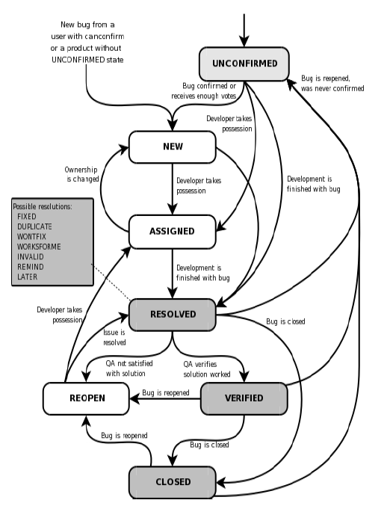
Introduction
Research Problem
Identify bugs that require additional time at an early stage
Source: Mozilla’s Bugzilla repository

Slide 4
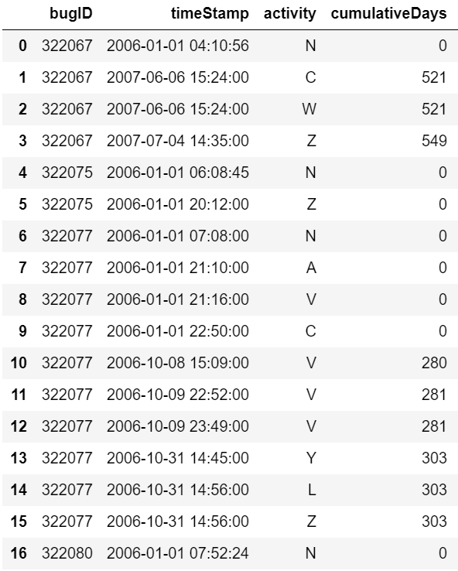
Approach
Extract temporal sequences of developer activities
Sequence for bug 322067:
N, C, W, Z

Slide 5
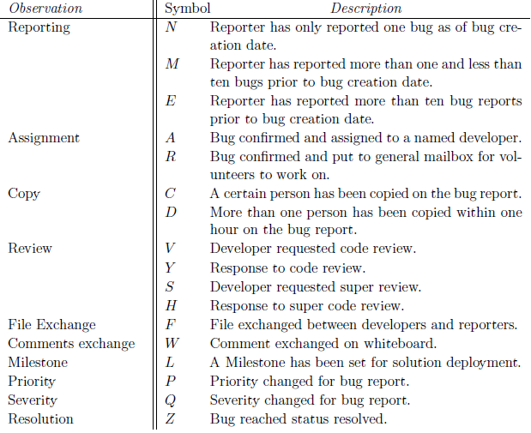
Approach
Full list of activities:
Notes:
Table 1 OR Table 3.1

Slide 6
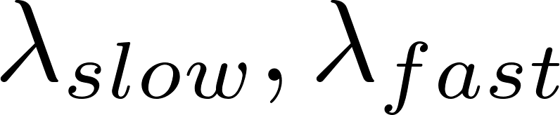
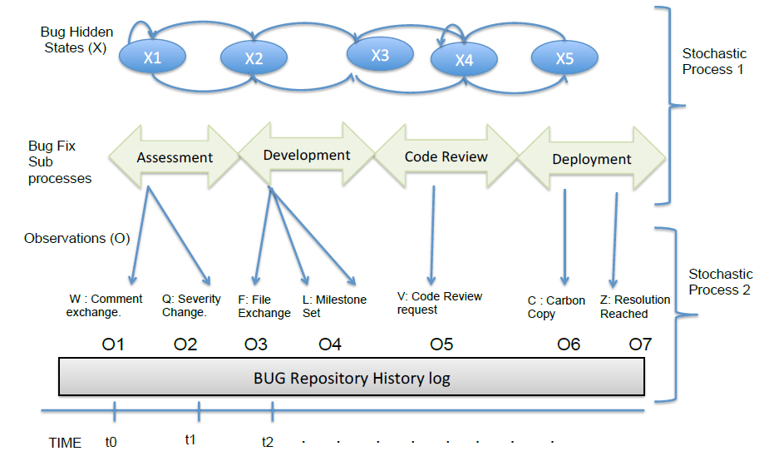
Approach
Train two different HMMs for bugs that are resolved quickly and slowly ( )
If total number of days to fix a bug exceeds 2 months it is classified as “slow”
Notes:
Figure 6 OR Figure 3.5

Slide 7


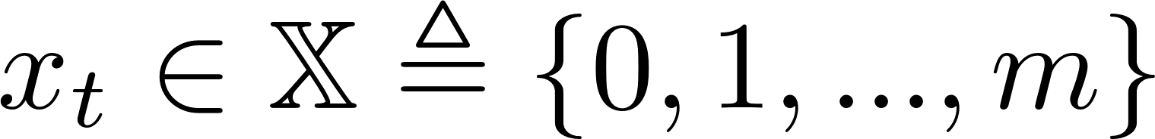
Approach
Components of HMM
Observation: An activity in the dataset ( ) at time t
Hidden State: A bug’s state in the defect fixing process ( - Code review, deployment, … at time t)
There are 16 types of observations
There are m-1 unique states

Slide 8
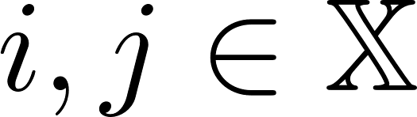
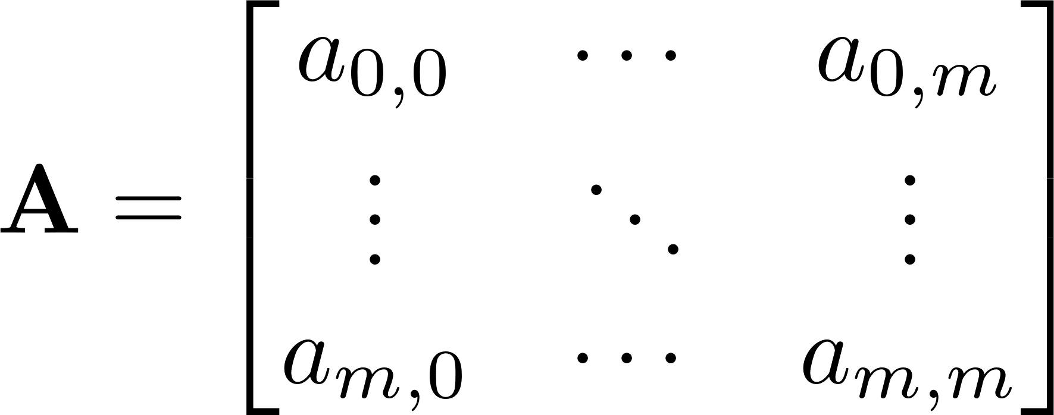
Approach
Components of HMM
Transition Matrix (A): Transition probability between states

Slide 9
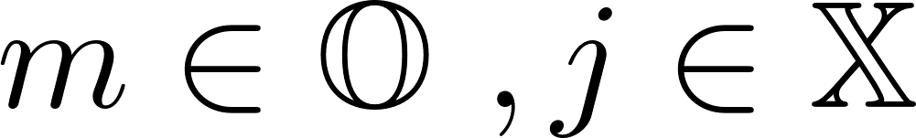
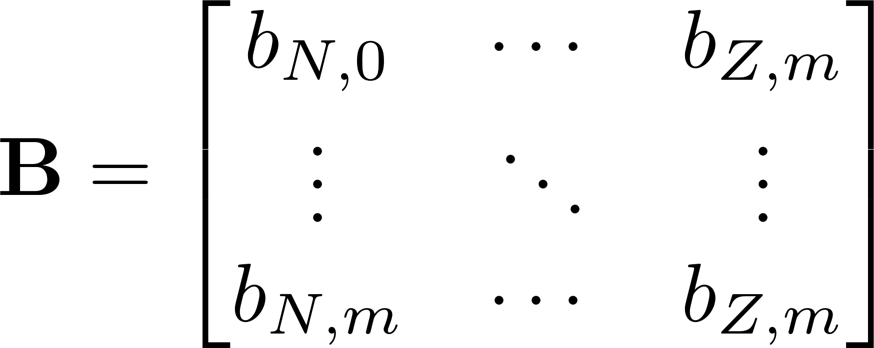
Approach
Components of HMM
Emission Matrix (B): The probability of detecting an observation at a certain state

Slide 10
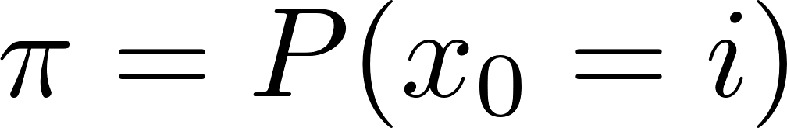
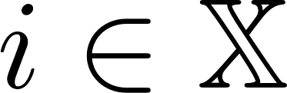
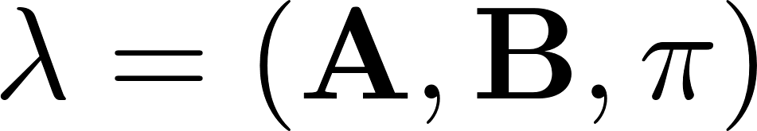
Approach
Components of HMM
Initial States (π): Initial state distribution at time 0.
The components of HMM can be represented as:

Slide 11
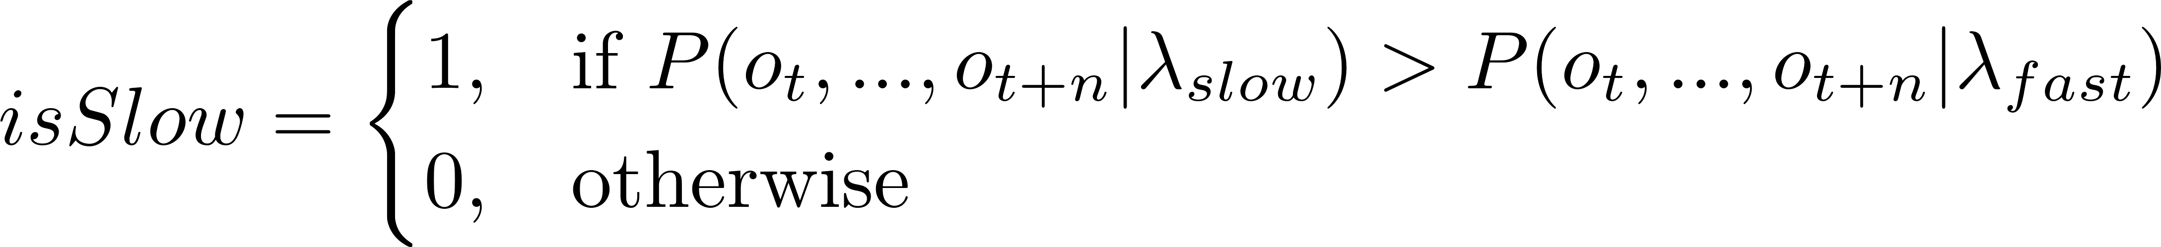
Approach
Testing
A sequence is assigned as slow if:
Likelihood of a sequence is calculated using the forward algorithm

Slide 12
Approach
Evaluation Criteria
Confusion matrix
True Positive: A slow bug that is assigned to the HMM associated with slow bugs
Precision: % of correctly classified slow bugs out of all bugs
Recall: % of correctly classified slow bugs out of all slow bugs
F-Measure, Accuracy

Slide 13
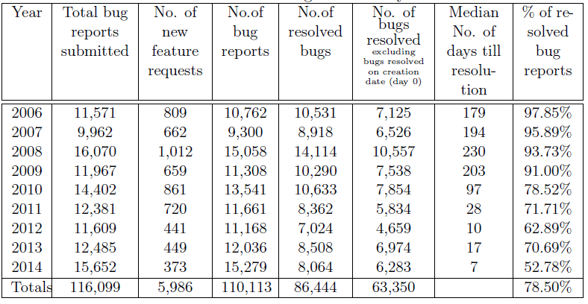
Dataset
Notes:
Table 6 OR 4.1

Slide 14
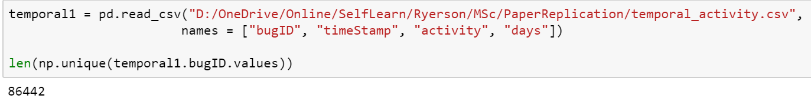
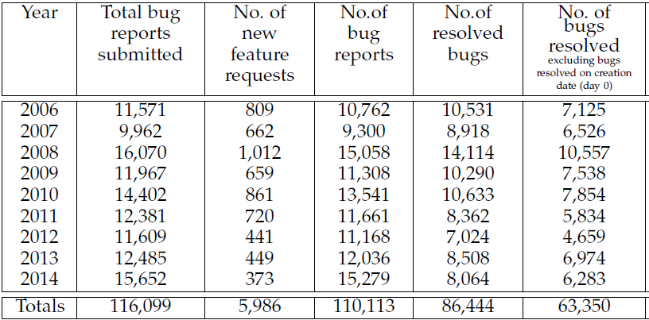
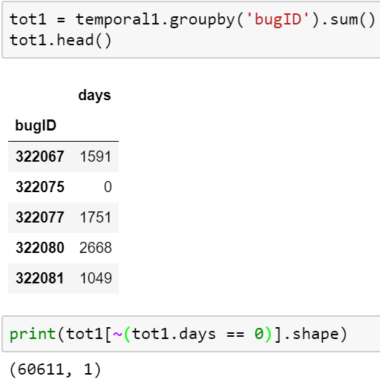
Dataset
Summary statistics do not match
Difference in our definitions for the day 0 bugs (?)
Had the same results in SQL as well

Slide 15
Experiments
Using fixed length sequences for classification
Using first week’s activities to predict the time to fix bugs
Using previous year’s data to predict the time to fix bugs

Slide 16

Experiment 1
Can we classify bugs using the first N members of the sequence?
Threats to replication
Sequences included in training/testing
Ex: If the number of activities we want to use is 5, do we use a sequence with only 3 activities?

Slide 17
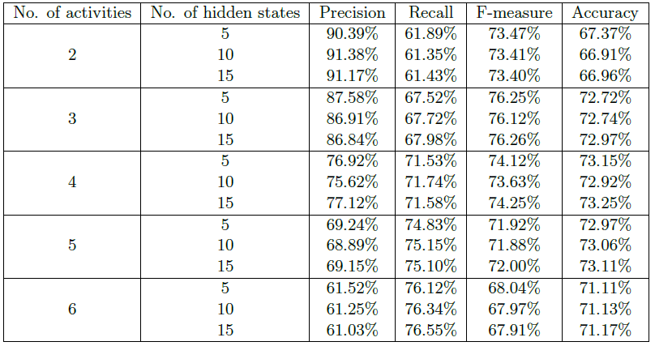
Results: Paper
Notes:
Table 10 OR Table 4.5

Slide 18
Conclusions
Accuracy and other measures are not significantly impacted by the number hidden states
Number of activities are positively related with recall, negatively related with precision

Slide 19
Results: Replication
Activities | Hidden states | Precision | Recall | F-Score | Accuracy
2 | 5 | 58.51% | 56.79% | 57.64% | 70.52%
 | 10 | 55.85% | 60.65% | 58.15% | 69.18%
 | 15 | 57.38% | 58.86% | 58.11% | 70.03%
3 | 5 | 55.69% | 79.11% | 65.37% | 70.40%
 | 10 | 61.27% | 73.37% | 66.77% | 74.21%
 | 15 | 62.33% | 71.31% | 66.52% | 74.65%
4 | 5 | 60.49% | 69.86% | 64.84% | 73.23%
 | 10 | 61.22% | 73.71% | 66.89% | 74.22%
 | 15 | 63.12% | 71.30% | 66.97% | 75.15%
5 | 5 | 61.51% | 71.13% | 65.97% | 74.09%
 | 10 | 60.89% | 72.77% | 66.30% | 73.87%
 | 15 | 63.13% | 70.81% | 66.75% | 75.09%
6 | 5 | 61.99% | 71.57% | 66.43% | 74.46%
 | 10 | 60.26% | 72.98% | 66.02% | 73.46%
 | 15 | 62.91% | 70.98% | 66.70% | 74.97%
Color indicates change compared to the original results

Slide 20
Conclusions
Accuracy and other measures are not significantly impacted by the number hidden states
Most of the replicated results match this pattern
Number of activities are positively related with recall, negatively related with precision
Results match for recall

Slide 21
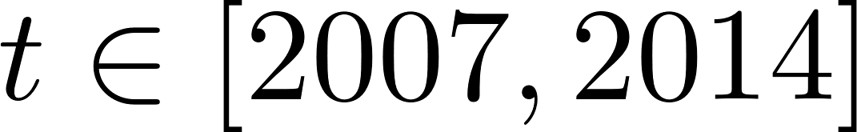
Experiment 3
Can we use year t-1 to predict the bugs in year t?
Threats to replication
For testing, used whole next year to validate results (In the paper they use a portion)

Slide 22
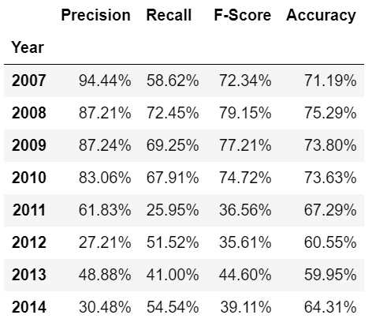
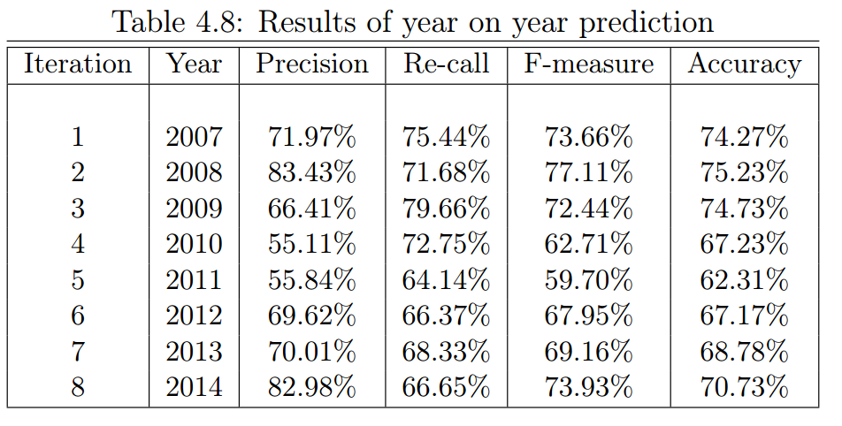
Results: Paper vs Replication

Slide 23
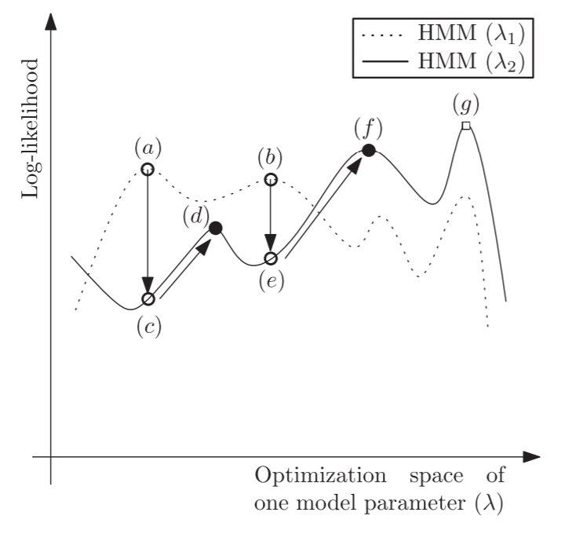
Overall Threats to Replication
Library used: HMMlearn
Initializations have a great impact on the results
[1] Khreich, Wael, et al

Slide 24
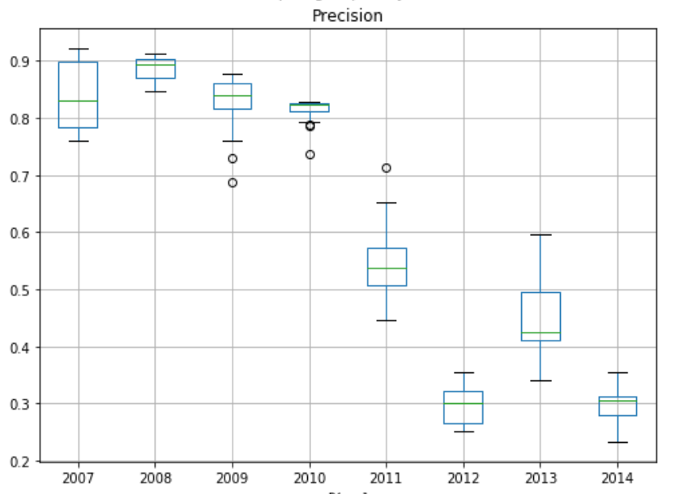
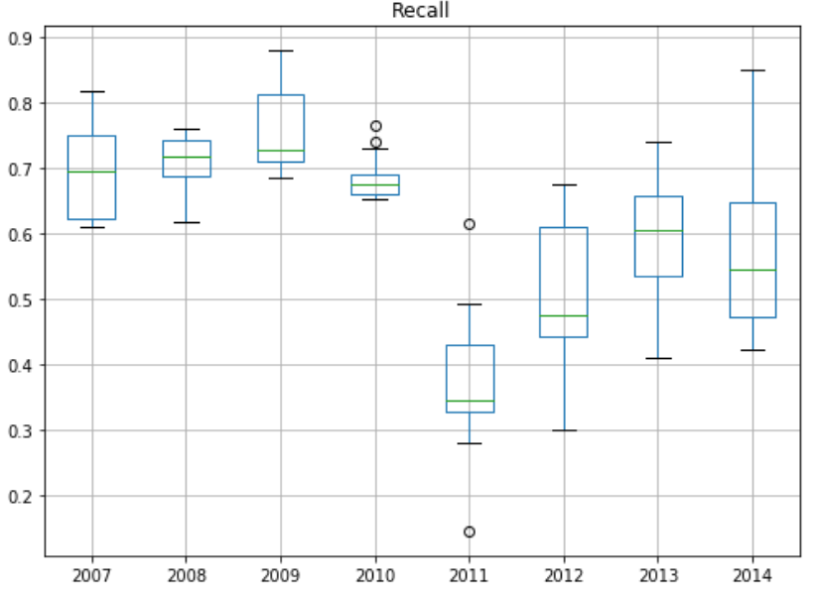
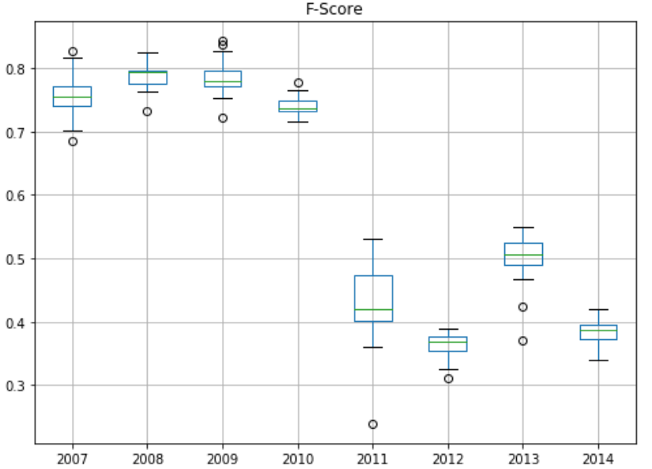
Overall Threats to Replication

Slide 25
Overall Threats to Replication
Increasing the iteration count improves the values
Causes overfitting
Validation set can show the optimal iteration count

Slide 26
Thank you for listening!

Slide 27
References
[1] Khreich, Wael, et al. "A survey of techniques for incremental learning of HMM parameters." Information Sciences 197 (2012): 105-130.

